Slide 1

Sea Temperature Anomalies
Group 5
Notes:
Ashlee

Slide 2
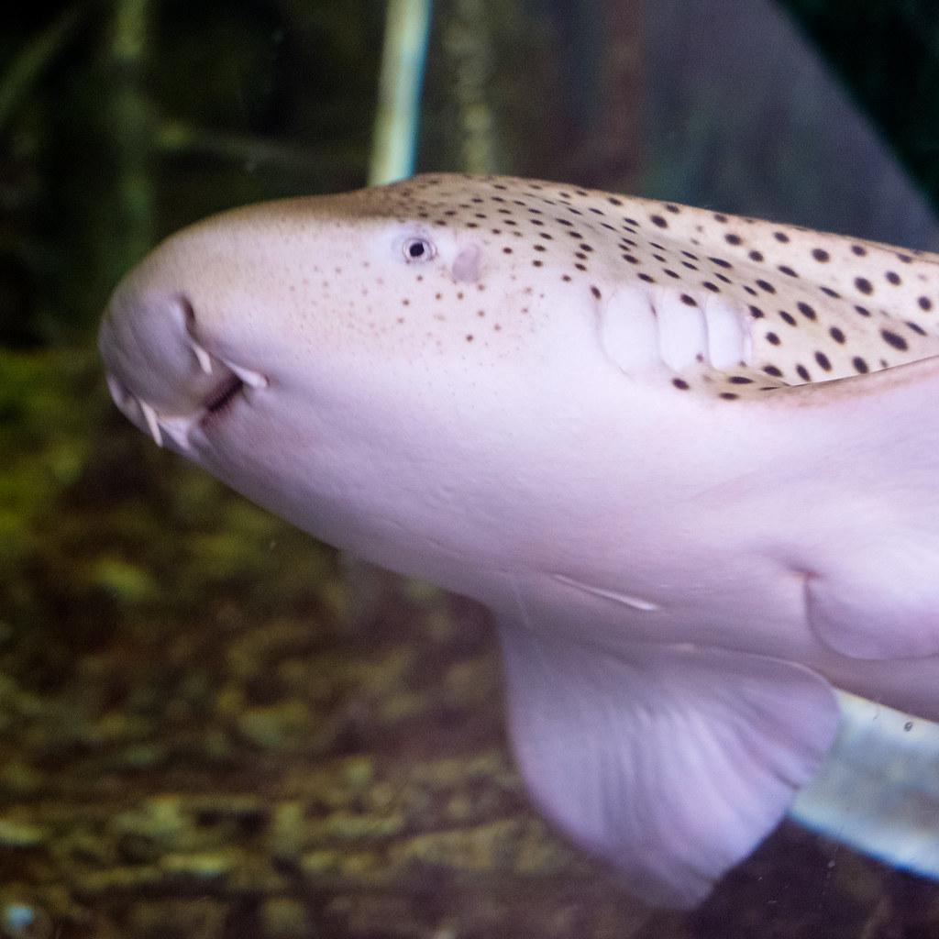


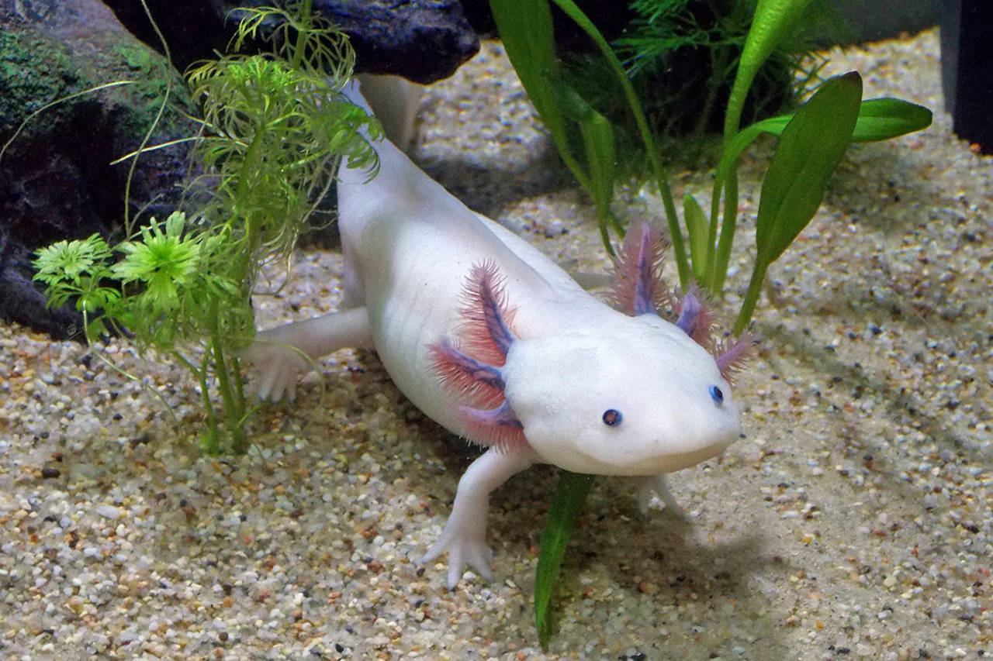

Meet the Team
Angeles S.
Ashlee T.
Bre H.
Leila C.
Rashini P.
sea temperature research, coding project assistance
sea temperature research, coding project assistance
sea temperature research, coding project assistance, presentation screen sharing
sea temperature research, coding project assistance, coding screen sharing
sea temperature research, coding project assistance

Slide 3
Introduction & Relation to Climate Change
Sea level and temperature anomalies relates to climate change, between the three data list we saw how over the years (1992 - 2016) the level of Seawater has increased this is due to how the temperatures around the globe have started to warm up because of climate change, which causes glaciers and ice sheets to combine and melt, therefore causing an seawater levels increase.
Why is this important anyways?
The sea plays a major part in keeping a balance between Co² and global warming. This means that, too much levels of Co² leads to a rise in global warming because Co² traps heat inside earth's atmosphere, while a drop in levels of Co² can lead to a drop in global warming as well. Additionally, not only does the expansion of seawater affect the atmosphere, but it also affects our coastal environment. For example, sea level rise encourages a rise in flooding and storm surges.
Notes:
Angeles & rashini

Slide 4
Why visualizations?
Without being able to see the changes in temperature over the years, the grid allowed us to see that by adding colors.
A grid also made the data a lot easier to read and follow and gave a really clear picture as to the location of these changes.
We use Python simply because it’s an easier way to perform a tedious task. With the large amount of data we had been given, Python made it a lot easier to make visualizations of the sea temperature anomalies, and gave us the libraries we would need to perform these tasks simply.
Notes:
bre

Slide 5
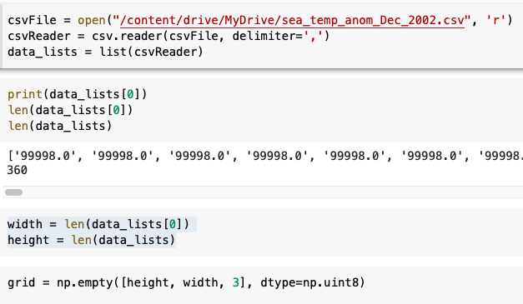
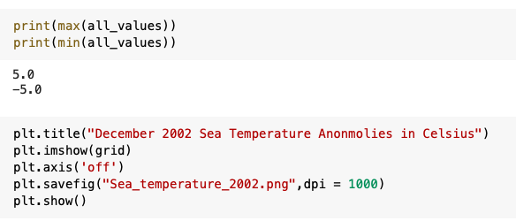
Library used: csv
When printing first row of data lists, we saw 9998 repeatedly
Minimum value: -5
Maximum value: 5
Map 1: December 2002 Code
Notes:
Rashini

Slide 6
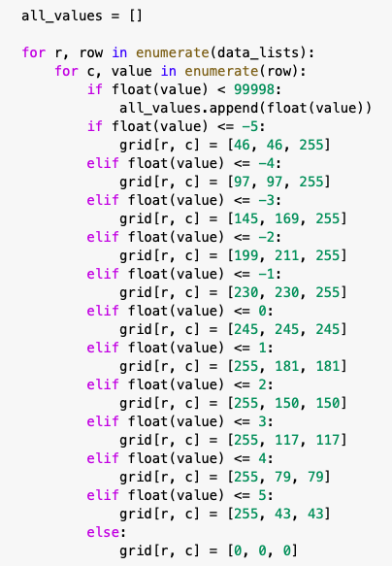
Map 1: December 2002 Code
Minimum value: -5
Maximum value: 5
Colors from blue to red
Graph type used: color map/grid
Notes:
Leila

Slide 7
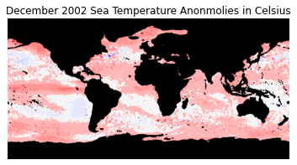
Map 1: December 2002
More blue: closer to -5
More red: closer to 5
In this visualization you can see that there are more red spots than blue spots in the oceans.
Notes:
Leila

Slide 8
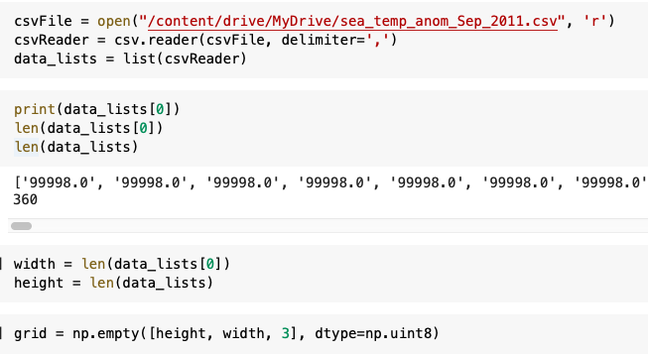
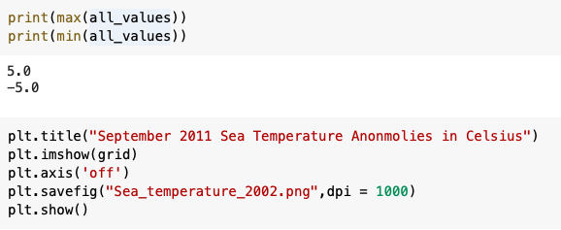
Library used: csv
When printing first row of data lists, we saw 9998 repeatedly
Minimum value: -5
Maximum value: 5
Map 1: December 2002 Code
Notes:
Bre

Slide 9
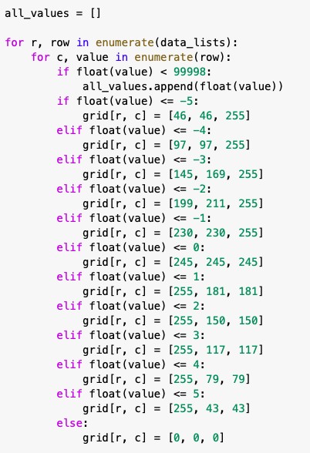
Map 2: September 2011 Code
Minimum value: -5
Maximum value: 5
Colors from blue to red
Graph type used: color map/grid
Notes:
Bre

Slide 10
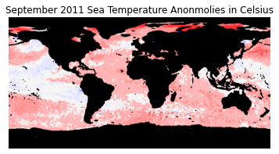
Map 2: September 2011
More blue: Closer to -5
More red: Closer to 5
And in this visualization, you can see that majority of the ocean is red, showing that is has gotten warmer over time. But, there is a little more blue west of South America.
Notes:
ashlee

Slide 11
Notes:
rashini

Slide 12
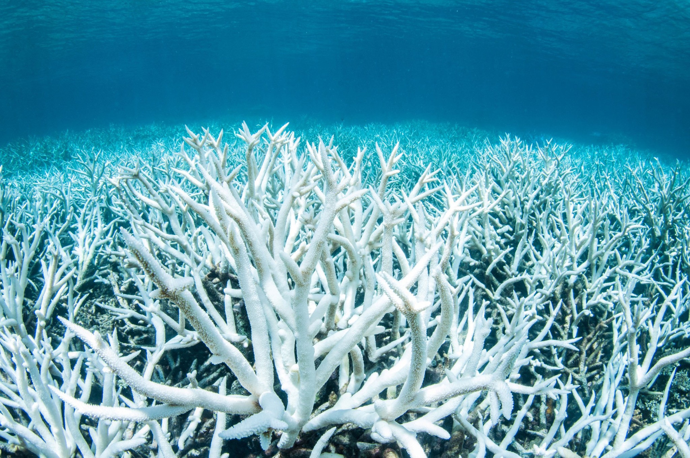
Scientific Conclusions
Scientific Conclusions
Scientific Conclusions
Scientific Conclusions
From our first two grids, we can observe that, when it came to the sea temperature anomalies, there is a large increase in temperature, especially towards the northern and southern poles, and a slightly decrease in small sections of the map.
This is extremely important as the warming of sea water can lead to things like the bleaching and eventual die-off of things like coral reefs.
This would be extremely harmful, not only
to the land, but to the organisms that depend
on them for food, and the people which depend
on them for income, medicine, and protection.
This is also only one of the many consequences
that come with these anomalies.
Notes:
rashini

Slide 13
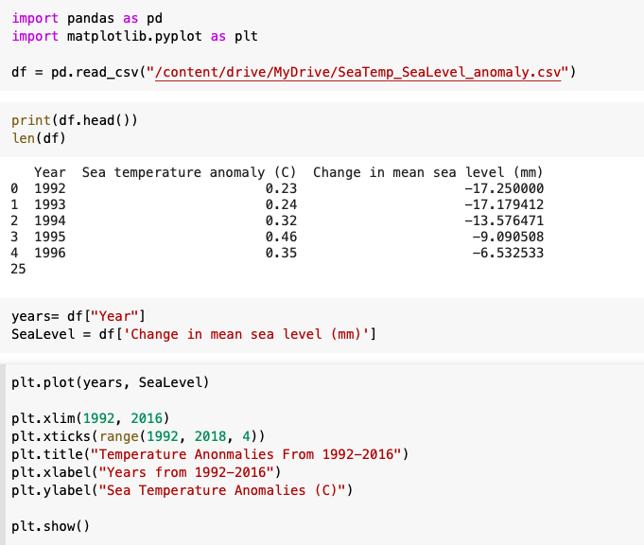
Graph 1: Sea Level Code
Libraries used: pandas, matplotlib
Chart type used: line graph
Variables used: year, SeaLevel
Notes:
ashlee

Slide 14
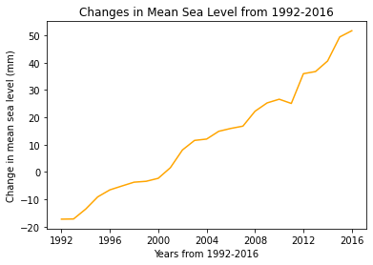
Graph 1: Sea Level
Graph 1: Sea Level
X-axis: years from 1992 to 2016
Y-axis: change in mean sea level in mm
Gradual increase over time
Notes:
ashlee

Slide 15
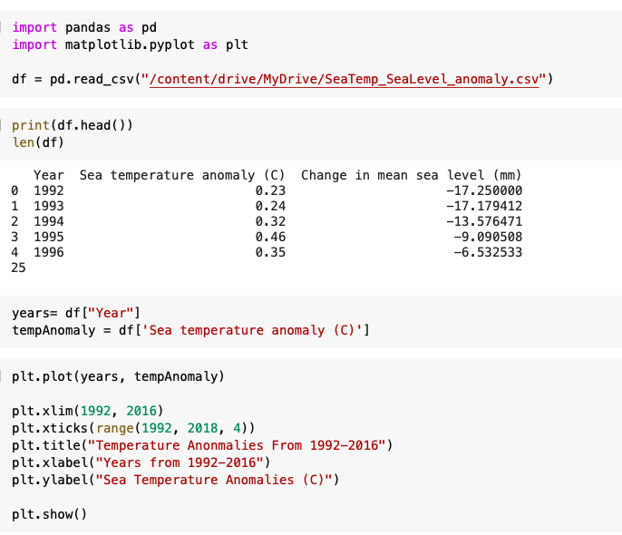
Graph 2: Sea Temperature Anomalies Code
Libraries used: pandas, matplotlib
Chart type used: line graph
Variables used: year, tempAnomaly
Notes:
Angeles

Slide 16
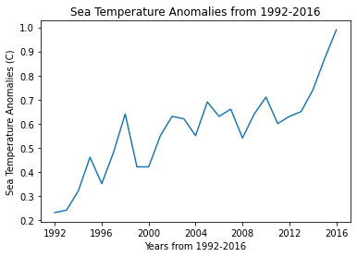
Graph 2: Sea Temperature Anomalies
Graph 2: Sea Temperature Anomalies
X-axis: years from 1992 to 2016
Y-axis: sea temperature anomalies in celsius
Gradual increase over time
Notes:
Angeles

Slide 17
Challenges & Solutions
Challenges & Solutions
Using the line graph for the last data list
Office hours
Using the correct code for the last graph
Understanding what graph we actually needed to write a code for
As a takeaway, a large thing we agreed on was communication and organization, especially when it came to assigning and performing tasks and making deadlines for ourselves to finish before ends of meetings.
Notes:
rashini

Slide 18
Takeaways & Next Steps
As a next step, because of the shear magnitude of the map, we didn’t really analyze smaller areas which could be greater or lesser affected by these changes in Sea Temperature and Sea Level.
We could use this large set of data as an opportunity to observe areas from afar and, afterwards, try to use more specific sections of data to analyze smaller sections of the earth.
This could be useful as, if there is a need for certain concentrated assistance efforts, we could narrow down the areas most affected.
This data could be used in several ways.
Notes:
Leila

Slide 19
Citations
https://earthobservatory.nasa.gov/global-maps/AMSRE_SSTAn_M
Bleaching on the Great Barrier Reef
Understanding Standing Sea Level and Climate Change(Climate.gov)
How is sea level rise related to climate change? (noaa.gov)
Coral Reef Ecosystems(noaa.gov).

